Slide 1
Loan Default Prediction
Team Members
Nikhil Bhoneja
Shanky
Yukin

Slide 2
Problem Statement
Loan default is a serious issue, both for the borrower (person, company) and the lender (bank, financial institution). When a borrower fails to pay back a debt according to an initial agreement, he is said to have defaulted.
For the borrower, this may lead to several serious consequences, like, a drop in their credit rating, withholding of assets by the financial institutions, legal consequences, and in a few serious cases, even bankruptcy.
For the lender, large volumes of ‘bad loans’ can impact the lender’s profitability, lead to credit losses and risk reducing equity, which will then make it more difficult to issue new loans.
Therefore, loan default is a serious matter, and we aim to create a robust prediction model, with high accuracy, that will allow banks to predict whether a borrower may default on their loan, based on a myriad of factors.

Slide 3
Dataset
The dataset used is a Loan Default dataset, with 148,671 rows and 34 columns. It consists of multiple deterministic factors, like: borrower’s income, gender, loan purpose, rate of interest etc.
The target columns, has 2 class labels (0 and 1) for borrowers that don’t default and borrowers that do.
The dataset was obtained from Kaggle. The link to the dataset is: https://www.kaggle.com/datasets/yasserh/loan-default-dataset
The dataset is subject to strong multicollinearity and empty values.
With such a detailed and exhaustive dataset, that has so many features, we built an extremely accurate prediction model.

Slide 4

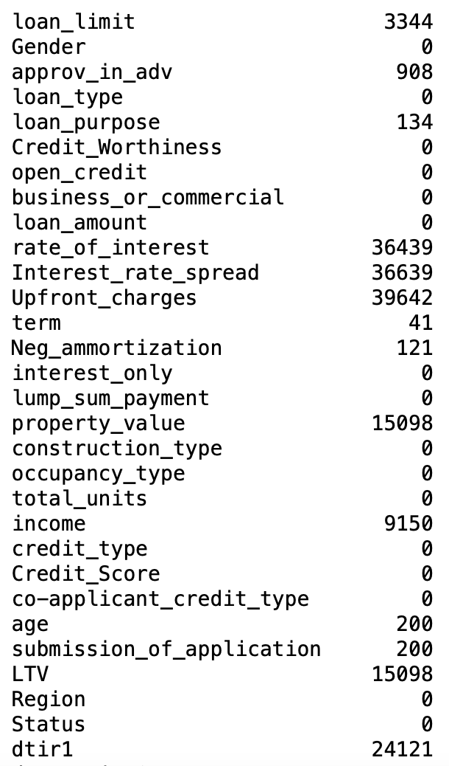
Step 1: Data Cleaning
Implementation
Our data set had many null values that we had to replace with meaningful data.
Depending on the column, we replaced the null values with the mean, median or mode of the column.
For some columns, whose null values could not be manipulated, the rows with the null values were dropped completely.

Slide 5
Step 1: Data Cleaning
Feature Name | Number of NAs | Replaced By
Income | 9150 | Median
Rate of Interest | 36439 | Median
Interest Rate Spread | 36639 | Median
Upfront Charges | 39642 | Mean
Term | 41 | Mode
Negative Amortization | 121 | Mode
Property Value | 15098 | Mean
Loan to Value Ratio | 15098 | Mean
Debt to Income Ratio | 24121 | Median
For columns: loan_limit, approv_in_adv, loan_purpose, age and submission_of_application, the rows with NA values were dropped.

Slide 6
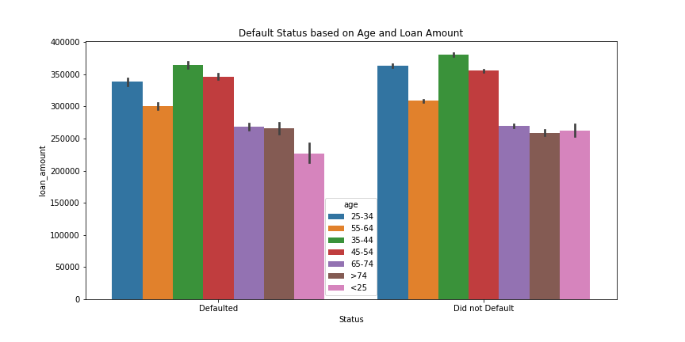
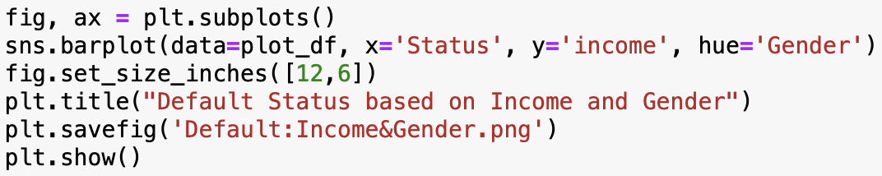
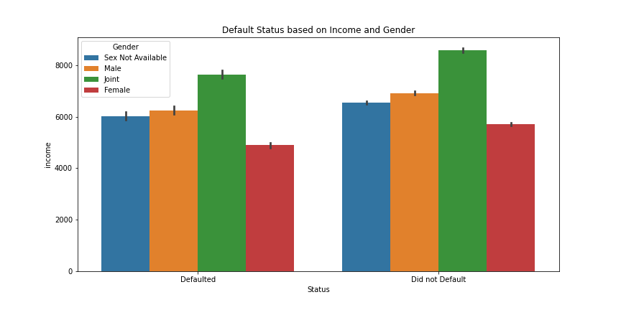
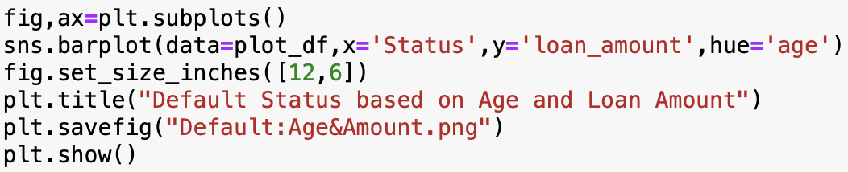
Step 2: Exploratory Data Analysis

Slide 7
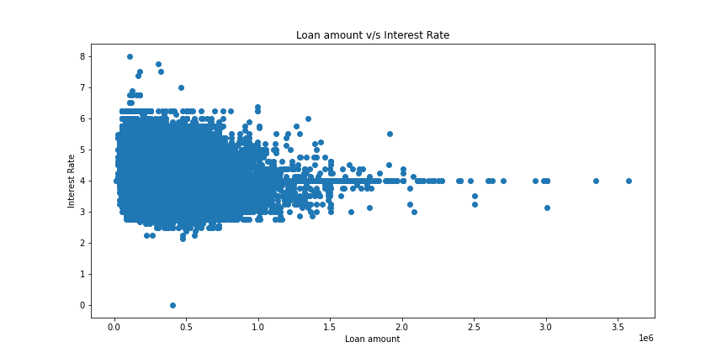
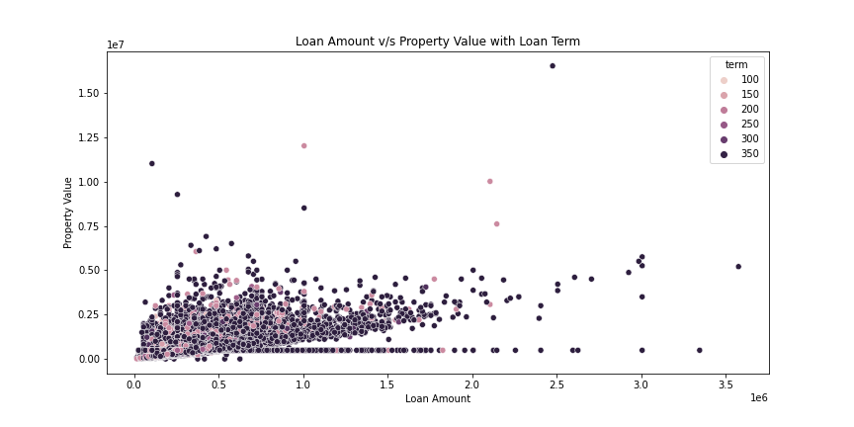
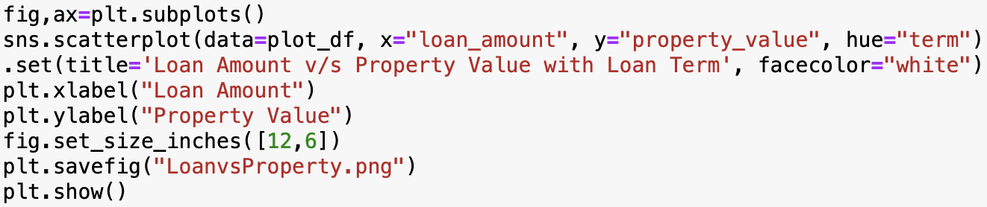
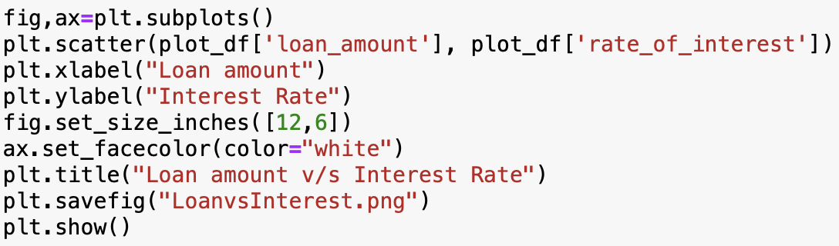
Step 2: Exploratory Data Analysis

Slide 8
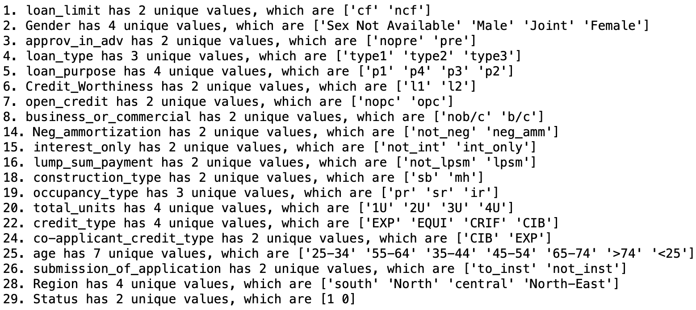
Step 3: Feature Scaling
a. Categorical Features
To ensure optimal model performance, we needed to Standardize our data.
To do so, we first looked at the categorical variables. These variables were then one hot encoded using the pd.get_dummies() function.
This converted the string categorical features to one-hot-encoded features that our models would understand

Slide 9
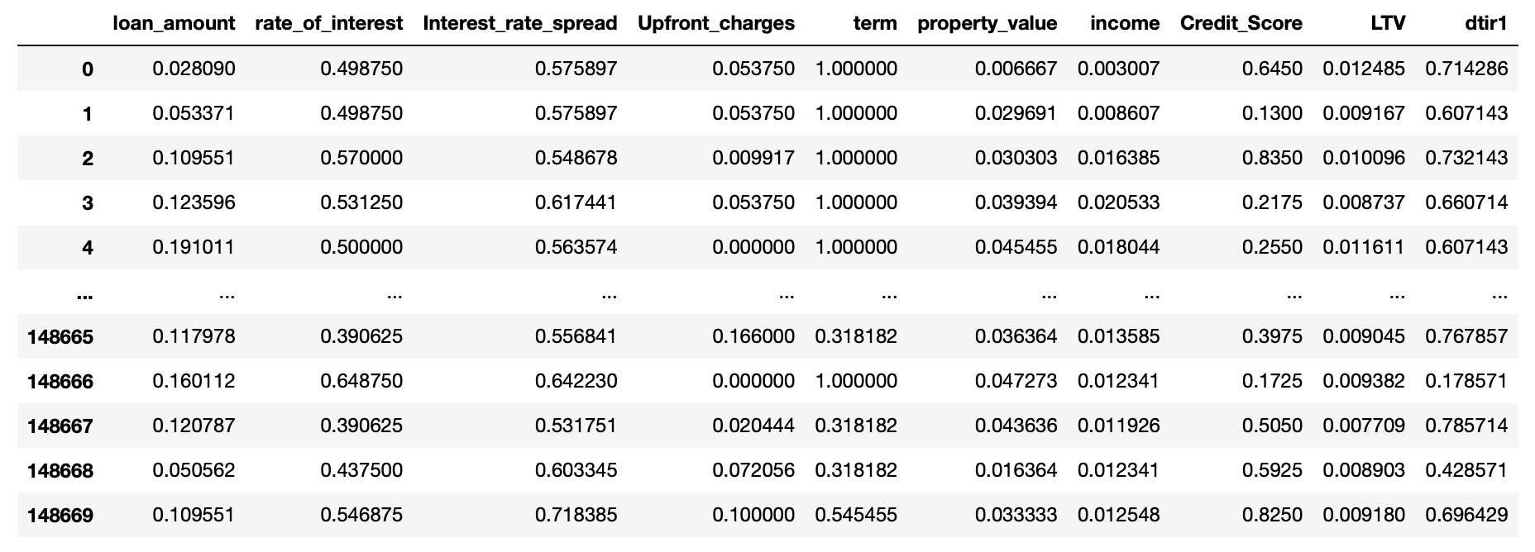
Step 3: Feature Scaling
b. Numeric Features
To ensure optimal model performance, we needed to Standardize our data.
To standardize the numeric features, we leveraged the MinMaxScaler() that sklearn offers.
The MinMaxScaler() finds the maximum and minimum values of a feature, sets them to 1 and 0, and scales all the other values accordingly, between 0 and 1.

Slide 10
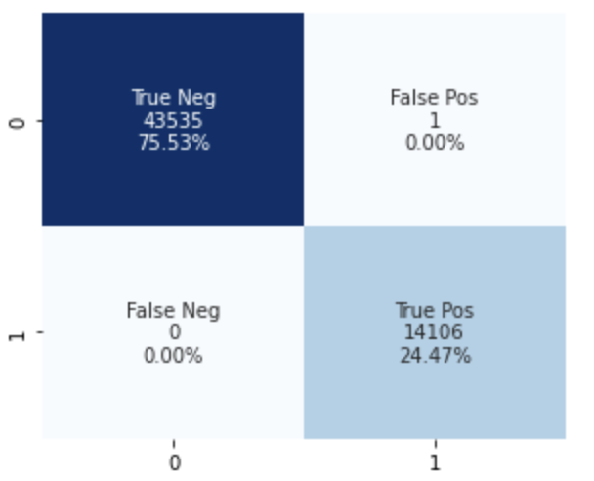
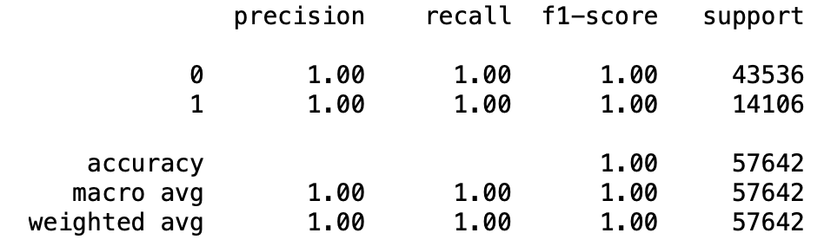
a. Decision Tree Classifier
Step 4: Modelling and Prediction

Slide 11

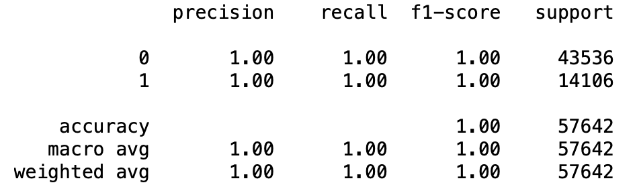

b. Random Forest Classifier
Step 4: Modelling and Prediction

Slide 12
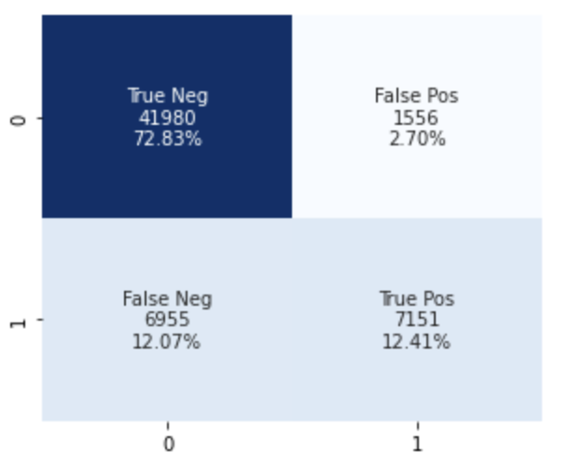
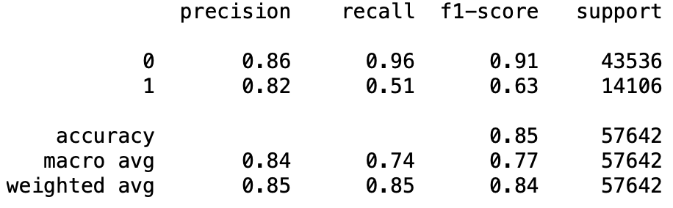
c. K-Nearest Neighbors Classifier
Step 4: Modelling and Prediction

Slide 13
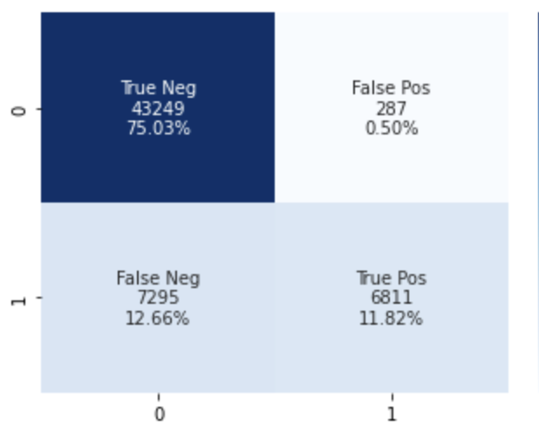
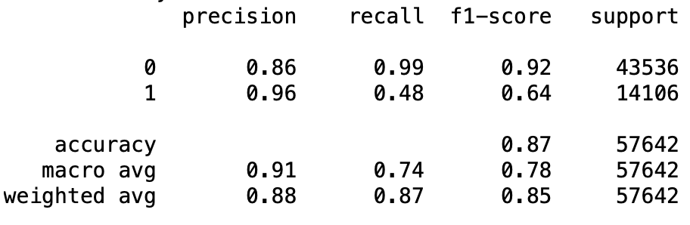
d. Support Vector Machine
Step 4: Modelling and Prediction

Slide 14
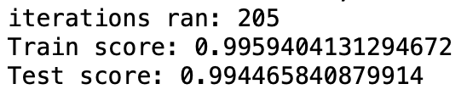
e. Artificial Neural Network (Multi-Layer Perceptron)
Step 4: Modelling and Prediction

Slide 15
Conclusion and Inference
Model | Accuracy (on test set) | F1 Score
Decision Tree | 0.99 | 0.99
Random Forest | 1.00 | 1.00
K-Nearest Neighbours | 0.85 | 0.84
Support Vector Machine | 0.87 | 0.85
Multi-Layer Perceptron | 0.99 | -
We can see that Random Forest gives us the best accuracy, followed by Decision Trees and a Multi-Layer Perceptron.

Slide 16
Thank you!

